Slide 1
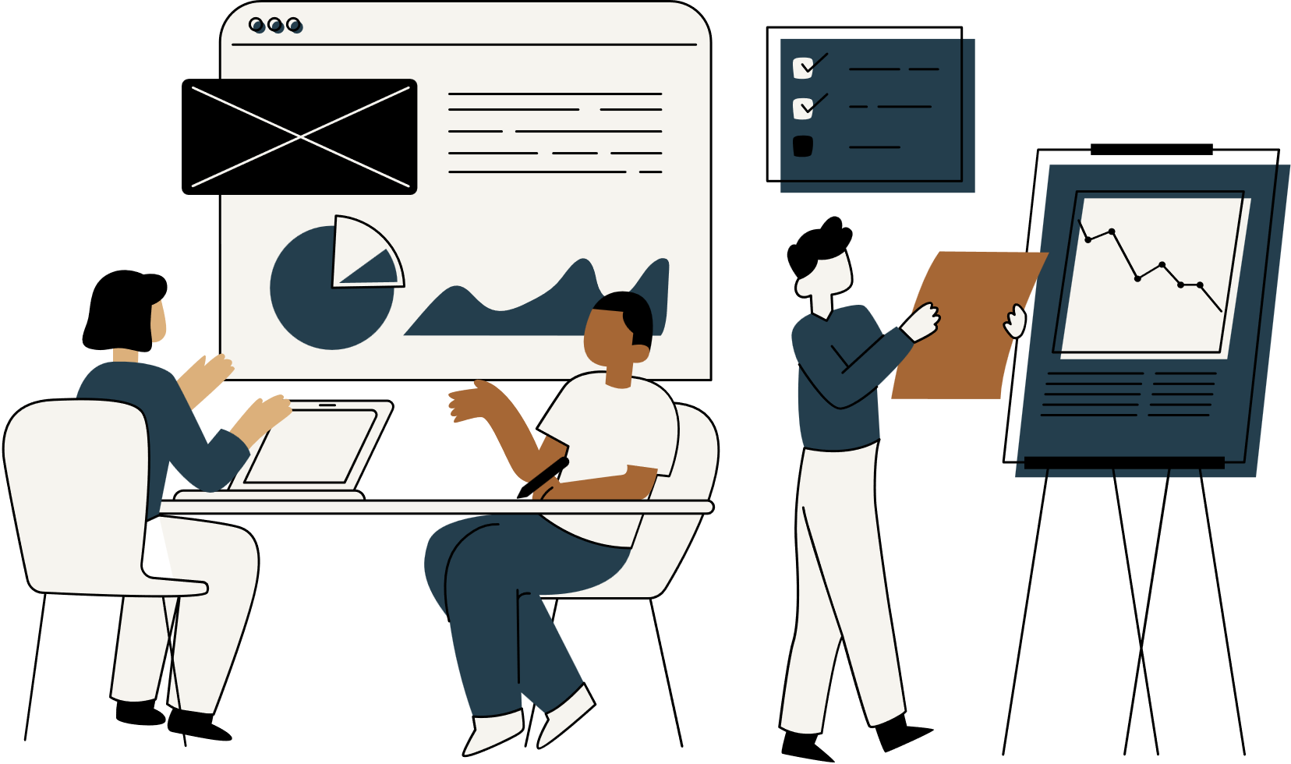

Hack o’ fest
Team & Idea description
Theme: Law & Justice
Idea description :Develop a digital platform that can help people to get legal help at their own convenience
Team Name: BINARY (4 members)
Institute Name: National Institute of Technology Patna (NITP)
Domain: Software
Team members : 1.Abhijaat Krishna 2.Snehal Prakash 3.Naman Mishra 4.Vansh Jaiswal

Slide 2
IDEA DESCRIPTION :
Access to legal information and consultation is a big problem in India because of high legal fees and unavailability of legal services in tier 3 and tier 4 cities.
There is a need to provide a user-friendly and easily accessible platform for legal advice and consultation.
The digital platform should be able to address common legal queries, such as:
1. What are my rights as a citizen?
2. How can I file a complaint?
3. How can I access legal aid services?
4. How can I obtain legal documents?
5. What are the legal implications of a particular action?
The digital platform should be able to connect to lawyers who can provide information on various legal topics, such as family law, property law, labor law, and criminal law.

Slide 3
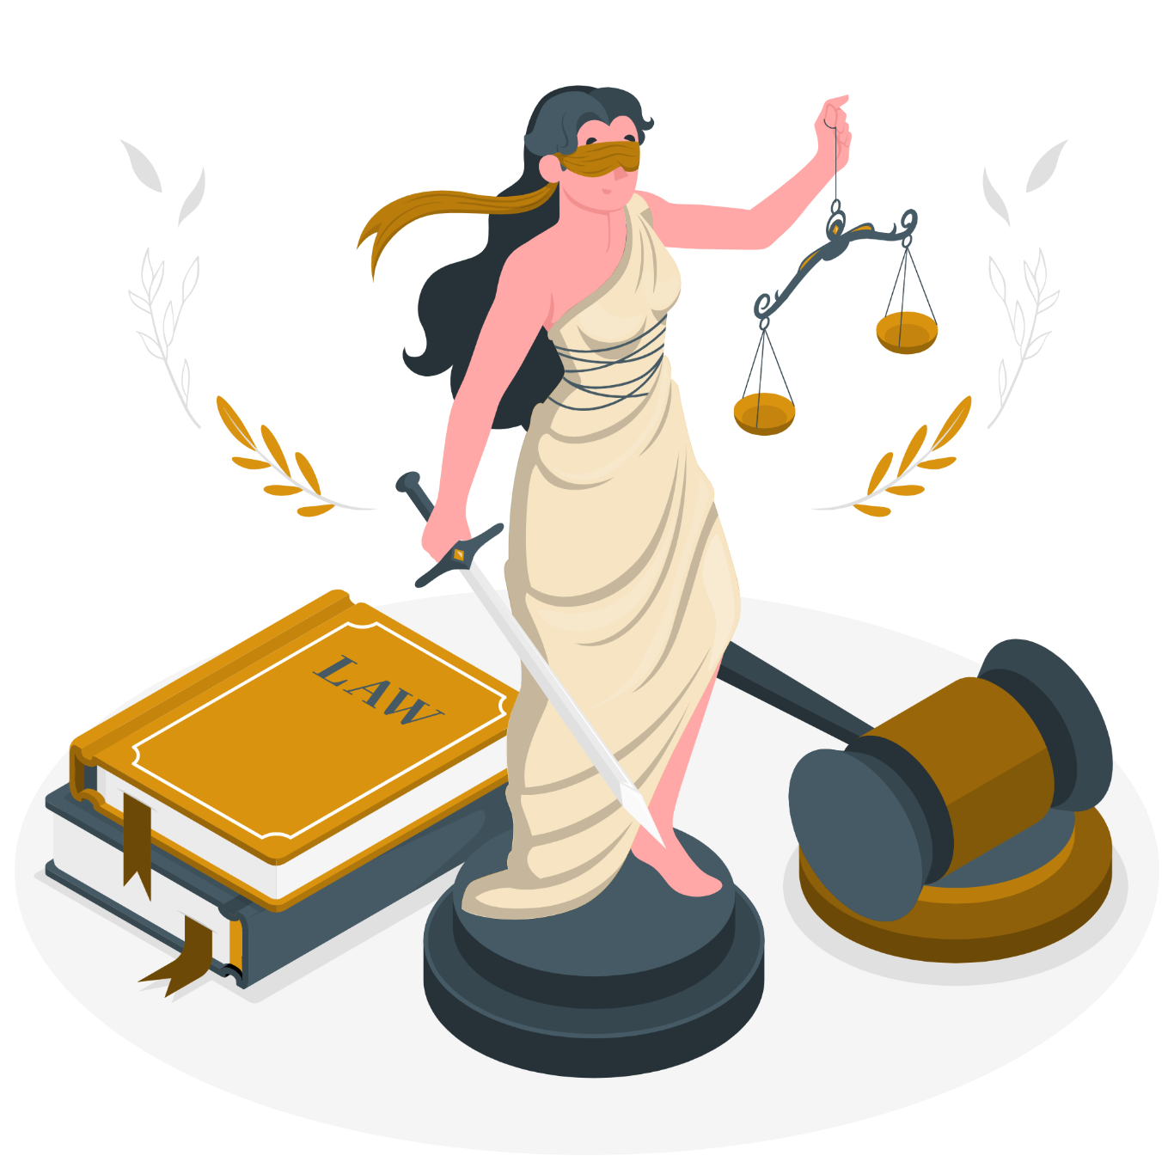
Current Solutions
National Legal Services Authority operates various legal aid clinics and initiatives across India to provide free legal services and increase legal awareness among marginalized communities.
“Legal literacy is an important limb of
the legal system to make people aware of their rights related to social security, health
services, education provisions, social care and employment.”
A
B
Services like the National Legal Helpline (15100) and state-specific legal helplines provide free legal advice and assistance over the phone to those in need.
Community Outreach Programs and Legal Literacy Campaigns educate people about their rights, laws, and legal procedures. Public announcements, and social media platforms are utilized to disseminate information about rights, laws, and legal procedures
C

Slide 4

PROPOSED SOLUTION :
A platform that is intuitive and readily available to make the legal help more approachable among the citizens. The platform contains following features :
1. Categorization of the problem
2. Connecting users with the lawyers of that field
3. Document transfer facility
4. User-friendly design
5. Availability of online booking of legal professionals to provide assistance and guidance
BENEFITS :
1. Increased awareness among citizens about their legal rights and entitlements.
2. Improved access to justice for citizens through a better understanding of the legal system.
3. Increased collaboration between legal aid providers and citizens.
4. Development of innovative solutions for legal education and awareness.

Slide 5
Proposed solution (implementation & technology used)
Home Page: Designing a home page with navigation buttons or tabs for easy access to different sections of the website.
Combined section: Implementing a feature to display a comprehensive list of laws, regulations, and statutes.
Categorization of Lawyers: Involves creating a section that allows users to search for lawyers based on their specific needs , displays relevant information such as their photo, practice areas, experience, education, contact details, availability, fee structure, and client reviews.
Online Booking of Legal Professionals: Implementing a booking system allowing users to schedule appointments with legal professionals directly through the website.
Legal document transfer/submission: Involves creating a secure and user-friendly system for users to upload, share, and manage their legal documents.
Technology used
Designing of wireframes or mockups for the home page and each section of the app by using Figma.
Creating the law website with HTML CSS JAVASCRIPT by involving several steps such as setting up the project, designing the UI, implementing navigation, integrating features, and testing.

Slide 6
Future scope & Scalability
Expansion into Legal Services: Beyond providing legal information and assistance, there is a growing demand for online legal services in India. The future scope of the app may involve expanding into areas such as online consultation, document drafting, e-filing services, and legal advisory services tailored to Indian laws and regulations.
Government Initiatives and Digitalization: The Indian government is actively promoting digitalization and e-governance initiatives, including initiatives like Digital India and e-Courts. Integrating with these government platforms and services can enhance the scalability and reach of the law app, enabling seamless access to legal information and services for citizens across the country.
User Education and Awareness: Educating users about their legal rights, obligations, and available legal resources is an integral part of the law app's future scope. Providing educational content, workshops, and webinars on legal topics relevant to Indian users can empower them to navigate the legal system more effectively.
Emerging Technologies: India is witnessing rapid growth in technology adoption, including smartphones and internet connectivity. Leveraging emerging technologies can enhance the capabilities of the law app, making it more efficient, accessible.
Thankyou

